Slide 1



Important uses of Matrices :
Application of
Matrices
Encryption:
Helps in encoding and decoding of data
Games:
Used to alter objects in a 3D Space.
Economics and business:
Study business trends and shares.

Slide 2

Problems encountered:
While applying the concept of matrices to solve problems, certain mathematical
operations are an essential aspect of the process.
Though they consist of basic algebra, they aren’t always simple for humans to calculate and solve.
High possibility of human error
Complex at certain phases.
Difficult to perform for large values
Process might contain multiple operations
Matrix Calculations

Slide 3

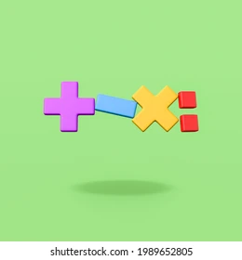
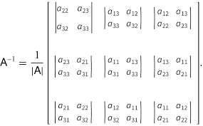
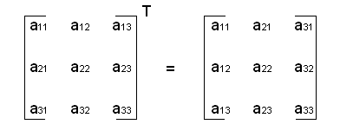
The Solution: Matrix Calculator
Working of the Calculator:
The logic for operations are programmed into the software.
An interface is made and connected to the database containing logic.
The interface provides the options to enter user-input.
The calculations are performed and desired output is obtained.
Operations to be performed by the calculator:
Determinant of square matrices.
Addition of matrices.
Subtraction of matrices.
Scalar Multiplication.
Multiplication of matrices.
Transpose of a matrix.
Inverse of a matrix.

Slide 4

How the problem is solved:
By automating the process of calculation with the Matrix Calculator we avail the following features:
Reliability: Tests perform precisely same operations each time they are run, thereby
eliminating human error.
Reusability: The software can be reused infinitely for performing a variety of
operations.
Time-saving: Complicated calculations are done within short time span.
Modifiability: The system can be upgraded or used in succession with another system.
All these features thus solve the problems faced in performing matrix calculations manually, by replacing it with accurate and precise automation.

